Slide 1
Annual Enrollment 2025 Overview
What’s New and Changing
October 29th and 30th
Notes:
Erin
Hello everyone and thank you for joining me today.

Slide 2
Agenda
Annual Enrollment
  AE Communication Timeline
  What is Annual Benefits Enrollment?
  2025 Annual Benefits Enrollment Overview
  Eligibility
  Is Action Required?
  Dual Enrollment
  Suggestions On How To Prepare
  Additional Items for Consideration
What’s New and Changing for 2025?
  eGuide
  BCBS Basic Plan, Employee + Medical plan design Updates
  Kaiser Basic Plan, Employee Only Medical Tier Updates
  Tobacco Free Credit Changes
  New Teladoc Virtual Primary Offerings
  MetLife Supplemental Medical Plans Changes
  New MetLife Dental plan design Enhancements
  Health Savings Account (HSA) Plan Contribution Limit Changes
  Reimbursement Plan Contributions Changes (FSA Health Care/ Limited FSA)
  New 401(k) Savings Plan Super Catch-Up
  New 401(k) Savings Plan Self Directed Brokerage Window
Review of Current Benefits
Get Ready To Enroll!
  Annual Enrollment Checklist
  Resources
  Reminder – Online Annual Enrollment Nov. 6– Nov. 20
  Have Questions or Need Assistance?
Questions
Appendix
Notes:
Erin
Today I would like to run through Annual Enrollment, Quick Review of What’s New for 2025, What’s changing, as well as a quick refresh on our current benefits.

Slide 3
2025 Annual Enrollment
Notes:
Erin

Slide 4
What is Annual Benefits Enrollment?
The Annual Benefits Enrollment Period
This is a once per year opportunity for eligible associates to enroll in, make changes to, or opt-out of most benefit plans for the upcoming year.
This is the only time you are eligible to make changes unless you have a qualifying life event, such as a family or employment change.
What’s a Qualifying Life Event?
A qualifying event that allows for a special enrollment period outside of annual enrollment.
Example of Qualifying Life Events (not inclusive):
Change in marital status
Birth of child/Adoption
Change in employment
Change in dependent eligibility due to plan requirements (e.g., loss of student status, age limit reached)
Change in residence (e.g., associate or dependent moves out of plan service area)
Change in coverage of spouse or dependent under another employer plan (e.g., spouse's employer had no insurance coverage before but now offers a plan)
Judgments, decrees or orders
Entitlement to Medicare or Medicaid
Notes:
Erin
Annual benefits enrollment is your annual opportunity to review your benefits, your family's needs, and fine-tune your benefits package to match. Many life events can occur during the year that can affect the types of plans and the amount of coverage you may need. So think about those changes that you and your family have experienced in the past year or anticipate in the coming year, then determine which benefit plans and programs will suit your needs best.
Outside of this annual enrollment period, you will not be able to make changes to most of these plans unless you've experienced an IRS qualifying life event, such as marriage, birth of a child, or a change in your spouse's employment.

Slide 5
2025 Annual Benefits Enrollment Overview
Enrollment Period:
  November 6 – 20, 2024
Enrollment Type:
  Active – All associates must actively enroll to have the following benefits in 2025:
    Medical Coverage
    Reaffirm/update Tobacco Use Status (default results in Tobacco Use Surcharge applied)
    Reaffirm/update Spousal Surcharge Elections (default results in Spousal Surcharge applied)
    Dental Coverage
    Vision Coverage
    Flexible Spending Accounts (Healthcare & Dependent Care)
    Health Savings Account
Dual Enrollment:
  There will be salaried and hourly associates who will need to enroll twice – 1. as a new hire and 2. for 2025 benefits.
  Enrollment Site: www.88sears.com
    Quick Links
      Health Benefit Center
      Financial – 401(k) Benefit Center
  Enrollment Resources:
    Annual Enrollment Guide
    Enrollment Reference Document
    Annual Enrollment Poster
    Enrollment Checklist
    Annual Enrollment Presentation
    FAQ’s with Talking Points
    2025 Benefits at a Glance
    2025 New Hire Benefits Presentation – Coming Soon
Notes:
Erin
Key Dates you will need to remember:
Annual enrollment begins on Wednesday, November 6, 2024
Annual enrollment ends on Wednesday, November 20, 2024
Benefits elected during annual enrollment will be effective January 1, 2025
Call out silent period as a special case scenario, not the normal expectation – silent period +5 day, special scenarios will exist and be addressed and reviewed by the Benefits Department.

Slide 6
Eligibility
 | Full-time Salaried *Eligible Date of Hire | Full-time Hourly *Eligible after 90 days of employment | Part-time Hourly (avg. 20+ hours) *Eligible after 90 days of employment
Medical Plans | ✓ | ✓ | X
Dental Plans | ✓ | ✓ | ✓
Vision Plans | ✓ | ✓ | ✓
Health Savings, Flex Spending and Commuter Benefit Accounts | ✓ | ✓ | X
Whole Life with Long Term Care | ✓ | ✓ | ✓
Basic Life Insurance | ✓ | ✓ | X
Optional Life and AD&D Insurance | ✓ | ✓ | ✓
Supplemental Medical Plans (Critical, Accident, Hospital) | ✓ | ✓ | ✓
Short-term Disability | ✓ | ✓ | X
Long-term Disability | ✓ | ✓ | X
401(k) Savings Plan | ✓ | ✓ | ✓
Employee Assistance Program (EAP) | ✓ | ✓ | ✓ (after a year of service)
*You must enroll within 31 days of your Date of Hire regardless of your benefits eligibility date
Notes:
Erin
This is a very important slide. If you are salaried associate you become eligible for benefits from your date of hire. If you want to enroll into benefits for the remainder of the year, you must do it within 31 days from your date of hire. When you log in to your benefits portal, system will prompt you to complete dual enrollment which means you’ll have to complete 2 enrollment, one New Hire enrollment and second 2025 Open enrollment. And our 2025 open enrollment dates are Nov 6 to Nov 20th If you do not complete open enrollment your medical, dental, vision and spending account elections will not carry over to next year. If you want to make any changes or even if you want to keep the same benefits that you are going to be electing for 2024 you need to go in to the benefits portal and complete the enrollment.
If you are hourly associate you become eligible for benefits after 90 days of employment. So if you are hired after October 2nd your benefits will kick off in January 2025 and you will be able to sign up for benefits from Nov 6th through Nov 20th

Slide 7
Is Action Required?
Annual Enrollment is⇦ ACTIVE ⇨meaning you are required to take action if you would like to continue certain benefits into 2025. Below is a listing of benefits that require action and those that do not – please review carefully.
Benefits that⇦ Require Action ⇨
Medical Coverage
  Reaffirm/update Tobacco Usage Status (default results in Tobacco Use Surcharge applied)
  Reaffirm/update Spousal Surcharge Elections (default results in Spousal Surcharge)
Dental Coverage
Vision Coverage
Flexible Spending Accounts
  Healthcare Flexible Spending Account
  Dependent Care Flexible Spending Account
Health Savings Account
Benefits that Do Not Require Action
Optional Life and AD&D
  Associate coverage
  Spouse coverage
  Child(ren) coverage
Long-term Disability
401(k) Savings Plan
Allstate Group Whole Life with LTC -
Supplemental Medical Plans – NEW Vendor for 2025 Note – Your current elections with Cigna will transfer to MetLife automatically. Elections may be updated during the Annual Enrollment period.
  Hospital Care
  Accidental Injury
  Critical Illness
Notes:
Sue
Your 2025 annual enrollment is considered an ACTIVE enrollment, which means there are certain benefits you are required to take action on or they will default to no coverage in 2025. Yes, this means even if you want to keep your benefits the same.
Annual Enrollment is the time to make changes to your plan elections – maybe change from Enhanced to Basic. Choose to enroll in the Premier Vision Plan instead of the Basic Plan. Change your FSA election amount if you contributed more than you used in 2024.
In addition, the Supplemental Medical benefit is moving to a new vendor for 2025, so any associate who wishes to enroll will have to do so during AE.
Annual enrollment is also the time to re-attest to yours and your spouses tobacco use status. A tobacco free status does reduce your medical premium, this reduction is reflected in the base premium.
Last of all, quick reminder that this is the time to also make changes, increase coverage, or enroll in the supplemental medical plans, optional life and AD&D, and/or LTD – EOI may be required.

Slide 8
Dual Enrollment
Salaried associates are eligible for benefits on their Date of Hire and must enroll in 2025 benefits in the Benefit Center (Businessolver) portal during the Annual Enrollment event November 6, 2024 running through November 20, 2024.
Salaried Example:
DOH October 30, 2024 (benefits effective date of hire)
Step 1 – enroll in benefits effective 10/30/24 in the Health Benefits Center
Step 2 – enroll in benefits effective 1/1/25 during the Annual Enrollment event 11/6 – 11/20 in the Health Benefits Center
Hourly associates with a hire date of October 4, 2024 through November 20, 2024 will be eligible to elect benefits during the 2025 Annual Enrollment event, beginning November 6, 2024 running through November 20, 2024. Their benefits will be effective following 90 days of employment. Hourly associates hired after the 2025 Annual Enrollment close will be invited to enroll in benefits in the Businessolver portal by way of a newly eligible email notification.
Hourly Example:
DOH October 16, 2024 (benefits will be effective following 90 days of service)
Step 1 – enroll in benefits effective 1/14/25 during the Annual Enrollment event 11/6 -11/20 in the Health Benefits Center
DOH November 20, 2024 (benefits will be effective following 90 days of service)
Step 1 – enroll in benefits effective 2/18/25 in the Health Benefits Center;
enrollment must be completed within the 31 day enrollment window
Notes:
Sue
Salaried associates are eligible for benefits on date of hire. It is important to note that they must enroll for 2024 within 31 days of hire. They will also need to enroll for 2025 during Annual Enrollment.
Salaried associates hired in 2024 after 10/2 will still need to enroll for 2024, and will have an opportunity to enroll for 2025 at that time also.

Slide 9
Suggestions On How To Prepare
Make Choices that Fit your Needs
Your Responsibilities During Annual Enrollment:
Review all communications regarding Annual Enrollment
Educate yourself on plan offerings
If you are thinking about participating in an FSA consider your past expenses carefully to avoid potentially forfeiting unused funds
If adding a dependent make sure you have proper documents available to complete the dependent verification process.
Do you have a beneficiary on file? Now is the perfect time to review your beneficiaries and make necessary updates.
Ensure your changes or updates have been properly submitted by the deadline – November 20, 2024
Some things to consider when evaluating your benefit elections are: Monthly Premium, Provider networks, Deductible, Coinsurance, and Copays; Prescription coverage and costs and estimated out-of-pocket costs
Notes:
Sue
On this slide we list a few things you can do to help with your decision making during annual enrollment.
One of the most important things you can do is read all of the annual enrollment communications you receive. Believe me when I tell you, every message you receive was carefully crafted to ensure you have an awareness of what, when, and where. Don’t miss out because you didn’t read your email.
If you are thinking about participating in an FSA consider your past expenses carefully to avoid potentially forfeiting unused funds
If you are adding new dependents, make sure to have the proper documents available to close out the process.
EWhat impacts the monthly premium – deductibles, coinsurance, copays
Out of pocket costs – will they be upfront or spread out
nsure your changes or updates have been properly submitted by deadline – November 20, 2024

Slide 10
What’s New and Changing for 2025?
Notes:
Sue
Now that we’ve discussed what annual enrollment is and what is required, let’s take a look at what’s new for 2025.

Slide 11
2025 Annual Enrollment Benefits eGuide
Available October 24, 2024
Explore Your Benefits with the new 2025 Interactive eGuide
Our interactive Benefits eGuide continues to provide you with convenient and engaging way to explore your benefits. You can easily access all the essential information about your benefits in both English and Spanish by visiting:
www.TransformcoBenefitsGuide.com
The eGuide allows you to seamlessly connect with the information you need to make well-informed decisions about your benefits. It includes clickable links to flyers, embedded videos, and more! The eGuide is compatible with both desktop and mobile devices, ensuring convenient access from anywhere.
Explore the New Monthly Benefits Resource Highlights in the Lifestyle category
Notes:
Sue

Slide 12
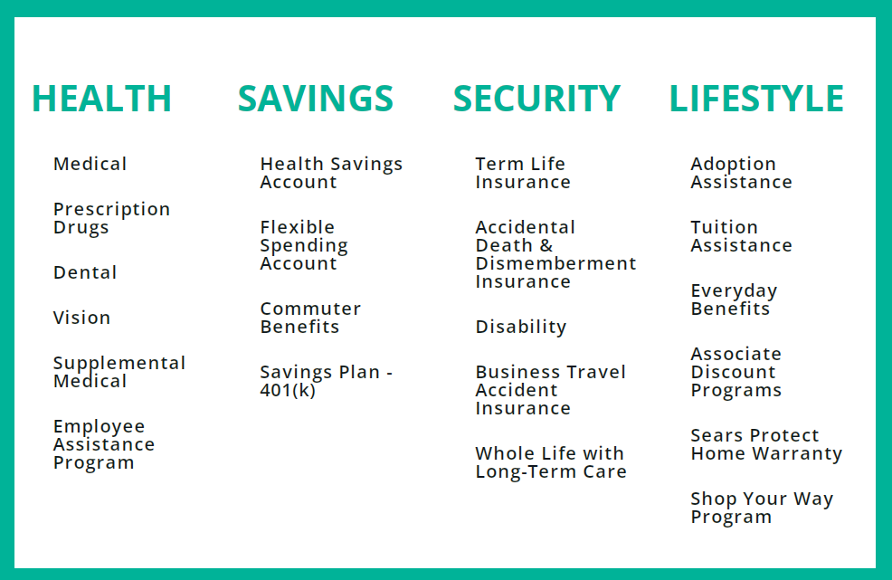
eGuide – Table of Contents
HOME
ELIGIBILITY + ENROLLMENT
ANNUAL ENROLLMENT CHECKLIST
HEALTH
SAVINGS
SECURITY
LIFETYLE
CONTACTS
AE VIRTUAL PRESENTATIONS
Notes:
Sue
During AE, there will be a tab showing all of the AE meetings scheduled with dial-in information.

Slide 13
2025 Medical Plan Pricing
Effective January 1, 2025
The medical plans have increased in cost for 2025, rates will be available to review in the portal on November 6th.
2025 Changes
BCBS Pricing: The Basic Plan will be the only carrier priced as the ACA Safe Harbor affordable plan for 2025.
Kaiser Pricing: The Kaiser Basic Plan - Employee-Only medical tier will no longer be offered at the ACA Safe Harbor affordability calculation effective January 1, 2025.
2025 Reminder
Medical Dependent Tier Subsidy is provided as additional overlay of dollars to the eligible associate electing EE+SP, EE+CH or FAMILY coverage – offered to Tech and Non-tech
Reaffirm/update Tobacco Usage Status (default results in Tobacco Use Surcharge applied)
Reaffirm/update Spousal Surcharge Elections (default results in Spousal Surcharge)
Notes:
Erin
You may recall we had a complex rating band configuration that we collapsed to zones have worked to collapse to 6 in 2019 and into 2 in 2024, no changes for 2025 and will revisit into 2026. Lawrence DC- Ocala DC- Morrisville DC , Morrisville is union all involve tiered pricing.
2025 Increase:
2025 FPL safe harbor contribution % is 9.02%. The percentage (9.02%) is multiplied by the 2024 FPL ($15,060), resulting in a maximum monthly employee contribution of $113.20.
BCBS – 8.7% - down from the 9.7% increase in 2024 aggregate across 3 plans range increases are ranging 11 – 22% increases for Zones 1 and 2 and 11- 26% for zone 3
Kaiser – 18.19% - aggregate across 2 plans range xx -xx
Triple S – 6% up from 2024 3% increase
Netcare – 0%
HMSA – 6% down from 2024 7.7% increase
Other Benefits
Dental – slight reduction to MetLife premiums
Vision – no change
Critical Illness, Accidental Injury, Hospital Care – premium reductions and plan enhancements
Life Insurance - Optional Life Insurance AD&D – no change
LTD – no change

Slide 14
BCBS Plan New & Changing
Effective January 1, 2025
Basic Plan (Employee Only) Changes
The BCBS Basic Plan, Employee Only medical tier will be the only 2025 plan offering that will be priced to the ACA Safe Harbor affordability calculation.
What this means for you: For 2025, if you are enrolled in the BCBS Basic Plan (Employee Only), your premiums will meet the ACA Safe Harbor affordability standards, ensuring that your plan remains cost-effective according to federal guidelines.
Basic Plan (Employee +) Changes
The BCBS Basic Plan, Employee + medical tiers will have a reduced In-Network Family Out-of-pocket Maximum, from $9,450 to $9,200.
NEW – Teladoc Virtual Primary Care offering for BCBS Basic and Enhanced Plans effective January 1, 2025
Important Note: MDLive will continue to be the Virtual Care offering for the BCBS HPN Plan in 2025
Notes:
Erin
Teladoc Virtual Primary Care is new, there is a presentation on this feature on 11/8

Slide 15
Medical Plans Highlights – BCBS changes
Summary (In-Network) | Basic BCBSIL HDHP PPO | Enhanced BCBSIL PPO | BLUEHPN BCBSIL High Performance Network Plan
Annual Deductible | Associate: $2,500 Family: $5,000 | Associate: $750 Family: $1,500 | Associate: $1,500 Family: $3,000
Co-insurance | After the Annual Deductible is met, you pay 20% and the plan pays 80% | After the Annual Deductible is met, you pay 20% and the plan pays 80% | After the Annual Deductible is met, you pay 30% and the plan pays 70%
Out-of-pocket Maximum | Associate: $5,950 Family: $9,200 | Associate: $5,000 Family: $10,000 | Associate: $5,500 Family: $11,000
Preventive Care* | Covered 100% No deductible | Covered 100% No deductible | Covered 100% No deductible/Copay
Prescription Drugs Retail Pharmacy (30 day) Mail Order Pharmacy (90 day) | 20% after deductible | $10 / $40 / $60 | $10 / $40 / $60
 | 20% after deductible | $25/ $100 / $150 | $25/ $100 / $150
Spending Account | Health Savings Account Limited Purpose Flexible Spending Account | Flexible Spending Account | Flexible Spending Account
Primary Care Physician (PCP) Specialist | 20% after deductible | 20% after deductible | $25 Copay $50 Copay
Emergency Room | 20% after deductible | $150 co-pay; then 20% after deductible | $150 Copay
Urgent Care | 20% after deductible | 20% after deductible | $50 Copay
Telehealth Virtual Care | Teladoc Virtual Primary Care PCP visit General Medicine Dermatology 20% after deductible | Teladoc Virtual Primary Care PCP visit General Medicine Dermatology 20% after deductible | MDLive $48/visit $0 Copay
Notes:
Erin
The current slide reflects a comparison of each plan and associated costs. Regardless of which medical plan you choose, the same types of services – preventive care, office visits, hospital stays, and prescription drugs – are covered.
With each plan, you will pay some of the expenses. The plans vary on the amount of cost sharing which will be your responsibility. Cost sharing is influenced directly by whether or not you choose in-network providers, preferred providers, or out-of-network providers each time you need care.
There is a detailed slide in the appendix that shows costs for Virtual Primary Care across plans.
MDLive – virtual general med visit $0
Teladoc VPC – virtual office visit, general med visit and dermatology – there is no out-of-network coverage for Teladoc telehealth

Slide 16
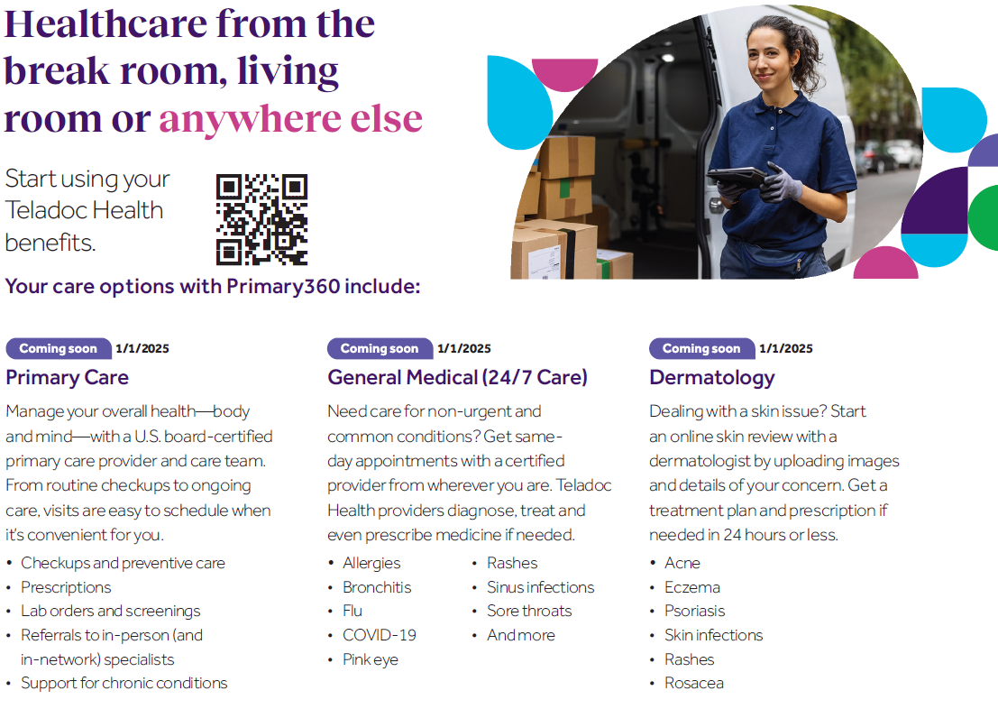
Teladoc Health – Virtual Primary Care
Notes:
Erin
Primary360 easily connects you to primary care so you can become your healthiest self.
Manage every bit of your health—body and mind—with a board-certified primary care provider of your choice and your own care team by your side. So you can live healthier ever after.
Achieve better health with Primary360 today
Teladoc.com/Primary360 | 1-800-835-2362
Annual checkups and wellness visits by phone or video
Dedicated time with your provider to talk through your medical history, challenges and needs
A personalized Care Plan so you can meet your health goals with ease
Referrals, prescriptions and lab orders as needed
General Medicine
Skip the trip to the ER Get care now by phone or video.
When it’s not an emergency, you’ve got Teladoc Health.
Teladoc Health providers are here for you 24/7, by phone or video.
Avoid the long wait times of an urgent care or the ER
Licensed providers help with conditions like the flu, bronchitis, rashes, sinus infections, and more
Get care from wherever you are
Feel better without leaving the house
Dermatology
Have your skin concerns evaluated by a licensed dermatologist
Clear, healthy skin is the goal, but sometimes you need help with:
TM-DRM-10E-C24-01_Workfrontnumber_C_mmddyy_initials
Have your skin
concerns evaluated by a licensed dermatologist
• Acne
• Rashes
• Eczema
• Rosacea
• And more
Teladoc Health Dermatology is available to you in a snap. Upload images
of your skin issue online or on the app. You’ll receive a custom treatment plan within 24 hours.
How it works:
Download the app or go online to register or log in Complete or update a brief medical history
Upload images of your skin issue online or on the app. You’ll receive a treatment plan within 24
hours. You may ask questions
for up to 7 days after you receive your plan.
Phone and video visits are not required or part of the dermatology visit.
Learn more

Slide 17
Kaiser Plan Design Changes
Effective January 1, 2025
Basic Plan (Employee Only) Changes
The Kaiser Basic Plan, Employee Only medical tier will no longer be offered at the ACA Safe Harbor affordability calculation effective January 1, 2025
What this means for you: Starting in 2025, associates who are enrolled in the Kaiser Basic Plan (Employee Only) will no longer benefit from premiums that meet the ACA Safe Harbor affordability standards. This could result in higher premiums for employees, meaning you may need to pay more out of pocket for your monthly insurance costs. It’s important to evaluate other available options to ensure your healthcare plans fits within your budget.
Notes:
Erin
When it comes down to it, healthcare is an expensive investment. Kaiser Permanente’s renewal for 2025 triggered a significant increase to premiums that were not negotiable. Transformco remains committed to offering associates a valuable, affordable benefits program that is the right fit for you and your family. To continue doing that, we made some changes to our medical offering for 2025.
The changes involve the cost of premium:
Kaiser Permanente- You’ll continue to elect from one of two coverage levels:
Enhanced: This coverage level is a preferred provider organization (PPO) option.
Basic: This coverage level is a high-deductible option that gives you the ability to contribute to a tax-advantaged Health Savings Account (HSA). The Basic Plan, Employee only tier, will no longer be priced as the ACA affordable option effective January 1, 2025.

Slide 18
MetLife Supplemental Medical – New & Changing
Effective January 1, 2025
Plan Carrier Change
The Supplemental medical plans will transition from Cigna to MetLife, beginning in 2025. This change includes several plan design enhancements and a reduction in monthly premiums.
Important Note: All claims incurred prior to 1/1/2025 must be filed with Cigna.
Plan Design Enhancements
Accident Insurance:
Increased dislocation, fracture, surgical and holistic benefits.
Critical Illness:
Reduced recurrence separation periods
Increased maximum payouts allowed and expanded coverage for existing cardiac, cancer and specified diseases.
Inclusion of infectious diseases, mental health and childhood illnesses.
Hospital Indemnity:
Elimination of waiting periods between hospital stays for benefit payouts.
Extended hospital confinement duration.
Inclusion of benefits for newborn care.
Notes:
Sue
Supplemental Medical is a type of insurance that helps pay for treatments and services that standard health insurance plans may not cover. While Transformco offers robust major medical plans, all plans have out of pocket expenses that are the responsibility of the participant. Supplemental Medical plans help cover the costs participants incur prior to reaching their deductible or the 100% coinsurance level of coverage by paying lump sums directly to the participant for specific events.
Improved Plan Designs – all of the carriers were asked to make adjustments to the 3 plan designs to bring them more in line with industry standard offerings. The current plans offered by Cigna have limited covered conditions with lower benefit payouts than we would like. All of the carriers were able to enhance portions of each plan to varying degrees. The MetLife enhancements were the most extensive and consistent.
For Accident: enhanced payouts for top 10 claims – benefits for ICU Admissions, Hospital Confinements, Surgical, Burns, Bone Fractures, Dislocations. Additional benefits including Childcare, Pet Care, Organized Sports Injuries, Puncture Wound, Wellness Screenings & Waiver of Premium.
− For Critical Illness: enhanced payouts for existing provisions and added benefits such as Cardiac Arrest, progressive illnesses such as Addison’s, Muscular Dystrophy, Type 1 Diabetes, Waiver of Premium, and the addition of childhood and infectious diseases. In addition, there are increased payouts for recurrences, decreased separation periods, and an overall increase in the lifetime benefit payouts.
− For Hospital Indemnity: enhanced payouts for ICU Admissions & Confinements and additional benefits including Waiver of Premium and Newborn coverage.
Cost to participants – even with the enhancements to the plans, MetLife was able to reduce overall costs to participants to a level below what Cigna charges for the current plan design. MetLife provided a significant decrease to the cost of Critical Illness, offered better prices for Accident Insurance and Hospital Indemnity. Overall the MetLife rates provide the most value.

Slide 19

Supplemental Medical Options - MetLife
Supplemental Medical Options
Plan Features | Accident Insurance | Hospital Care | Critical Illness
Coverage | Fracture, Burn, Ligament Damage, Concussion, + | Expenses associated with a qualifying hospitalization | Heart Attack, Stroke, Cancer, End Stage Renal Failure, +
Options | X | X | $10,000, $20,000, or $30,000
Guaranteed Acceptance | ✓ | ✓ | ✓
Payment of Benefit | Payment made directly to you | Payment made directly to you | Payment made directly to you
Family Coverage | ✓ | ✓ | ✓
Portable Coverage | ✓ | ✓ | ✓
What is supplemental insurance?
Supplemental insurance is additional coverage to your primary health plan.
Visit MetLife
Contact MetLife
1-800-438-6388
Claim Assistance
Notes:
What is supplemental insurance?
Supplemental insurance is coverage that you can buy in addition to your primary health plan. These policies can help provide coverage for certain kinds of illnesses, accidents and injuries, and life insurance.
What are the benefits of buying supplemental insurance?
For many, supplemental health coverage can be a cost-effective way to help with out-of-pocket costs.
Here are a few of the advantages to supplemental health insurance plans:
They can offer financial support when you experience unexpected medical situations.
The cash benefits can be used in any way you like (i.e. pay medical costs, household expenses, or even pet sitting and child care).
They are portable, meaning if you leave the company, you can take your supplemental coverage with you.

Slide 20
MetLife Dental Plan Design
Effective January 1, 2025
What's New:
Plan Enhancements for both the Basic and Enhances options.
Slight reduction in the Basic Plan monthly premiums.
New option available for associates in Puerto Rico, allowing out-of-network benefits to be processed using the negotiated network fees as the maximum allowable cost
Notes:
Sue
MetLife Dental Enhancements for Basic and Enhanced include:
Additional Fluoride frequency from once to Twice Per Year
ADA recommendation twice per year, as preventive maintenance, for patients under age 21
Space Maintainers under Type 1
Primarily used to prevent tooth movement following premature loss of primary teeth
Proactive application may prevent additional cosmetic correction (braces).
Removed Missing Tooth Exclusion.
Currently policy excludes coverage for implants or implant supported prothesis to replace one of more teeth missing before the individual obtained dental insurance; except for congenitally missing teeth

Slide 21


2025 Savings and Spending Account Limits
Health Savings Account (HSA)
Individual | Family | Catch-up
$4,300 | $8,500 | $1,000
Flexible Spending Accounts (FSA & DCFSA)
Healthcare FSA | Healthcare FSA Carryover | Dependent Care FSA
$3,300 | $660 | $5,000
Commuter | Parking | Transit
Pre-tax | $325 | $325
Notes:
Sue

Slide 22
Health Savings Account (HSA) Employer Matching Contributions - Increase
Effective January 1, 2025
All associates enrolled in the Basic HDHP and elect to contribute to the HSA are eligible to receive an employer matching contribution:
Individual:
$250
$500
$750
Family:
$1,000
$1,500
Note: The matching contribution will require associate participation of the minimum dollar amount (Individual $250, $500 and $750 and Family $1,000 and $1,500) with matching contributions deposited to active associate’s account on a quarterly basis.
Notes:
Sue

Slide 23
What is a Health Savings Account?
A Health Savings Account (HSA) is a personal investment account that you own. You can use it to save money, federal income-tax–free, to pay for qualified medical expenses. When you have medical expenses, including those that may apply to your deductible, you can choose to pay for them using the money in your HSA. Or, you can save the money for a future need – even into retirement.
The advantages of an HSA if you select a High Deductible Health Plan (HDHP)
Triple Tax Advantage:
  Contributions that you make to the HSA can be tax-free for you.
  Interest and investment earnings on your HSA balance are not taxed.
  Withdrawals used to pay for qualified medical expenses are not taxed.
Portable: Your money rolls over year after year and the account is yours to keep, even if you leave the company or retire.
Your HSA can be a tool for saving for retirement: investing part or all of your HSA balance makes your money work even harder – potentially growing tax-free for future health expenses.
Notes:
Sue
Call out Employer Matching Contribution

Slide 24
What is a Flexible Spending Account?
An FSA allows you to have a set amount taken from your pay before taxes, which lowers your income tax. The money is put into an account you use to reimburse yourself for eligible expenses.
Transformco offers two kinds of FSAs:
  The Health Care FSA is used to pay for most out-of-pocket medical, vision, and dental care expenses for you and your eligible dependents.
  The Dependent Care FSA is for eligible day care expenses for a dependent child under the age of 13, or elder care for a dependent adult, while you work.
You can enroll in one type of FSA or both. You contribute tax-free dollars to your FSA(s) through payroll deductions.
Determine How Much to Contribute
Determine the annual contribution you want to make to a Health Care account for health, vision, or dental care for you and your dependents, and/or a Dependent Care account for daycare expenses. Only expenses incurred on or after your effective date of coverage are reimbursable from your FSA. There is a roll-over feature of up to $640 for 2024, however funds remaining over that amount will be forfeited. In 2025, the rollover amount will increase to $660.
Notes:
Sue
Mention of Spending Accounts in the 2025 FAQs will give associates more understanding of how the accounts can work together.
Mention the Grace Period vs. Run-out Period.

Slide 25
2025 Commuter Benefit Program and Account Limits
Commuter Benefit:
Transform provides a way for associates to save on work-related commuting expenses through the Commuter Benefit Program.
The program allows you to pay for eligible commuting expenses with pre-tax dollars.
Questions | Commuter Benefit
What is covered? | Public Transportation – Bus-Train-Subway-Fairy Vanpool, UberPool, Lyft Shared (not a single rider Uber or Lyft) Parking – at or near work or near public transportation you use to get to work
How does the program work? | When you enroll, you select whatever transit product or payment method you need for your monthly commute. You can elect transit or Parking and select pre-paid or reimbursement method.
Pre-tax Vs. After-tax? | You may receive pre-tax benefits up to limits established by the Internal Revenue Service. For 2025, the combined limit for transit and/or vanpooling expenses is $325 per month, and the limit for qualified parking expenses is $325 per month. Elections above the IRS limit will be converted to After-tax.
Notes:
Sue
If you pay for parking at or near your office, you can set aside pre-tax funds to help you cover those expenses.
Also, you can save on gas money and help the planet by taking transit – which includes trains, buses, subway, ferry, a vanpool service or rideshare versions of UberPool or Lyft Shared (not a single rider Uber or Lyft).
Set aside up to $325/month for parking, transit, or both.
Set aside what you think you will USE each month.
Use your MyChoice Accounts debit card to pay at parking kiosks or to purchase transit fare/passes or pay/reload on transit apps.
IRS rules do not allow reimbursement for transit costs paid out of pocket—use your card!
Change your election at any time based on your current commuting status.

Slide 26
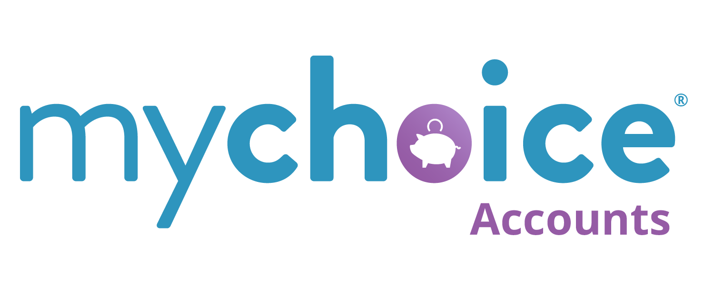
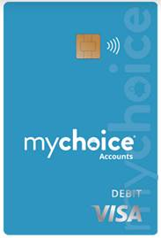
MyChoice Accounts Administration
MyChoice Accounts is your vendor for all spending accounts;
Health Savings (HSA)
Flex Spending Account (HFSA and DFSA)
Commuter Benefits
Access them directly through Benefitsolver or the MyChoice® Mobile App, where you enroll in and manage all your benefits.
New enrollees will receive a MyChoice Accounts debit card after completing the new-hire enrollment process.
Notes:
Sue
So HSA, FSA and Commuter benefits are administered by MyChoice so if you choose to enroll in any of these three benefits you will receive this chip enabled MyChoice Visa debit card.
You can use this card to pay for eligible expenses with a simple swipe. You will receive this in the mail after your enrollment is confirmed. The card is issued by UMB Bank.
You simply activate the card, establish a PIN, sign the back of the card and begin using for eligible expenses.
The card is accepted at most major retailers, medical/dental/vision providers. Some purchases may require verification, so be sure to save receipts and other documentation to help support the reimbursement.

Slide 27
2025 Savings Plan Contribution Limits
US Savings Plan
Pre-tax and Roth 401(k) | After-tax | Pre-tax and Roth 401(k) catch-up
Between 1% and 50%, up to the 2024 IRS maximum limit of $23,000* | Between 1% and 25% The total of your pre-tax and after-tax contributions cannot exceed 50% of your eligible pay. | Between $1 and $7,500*
PR Savings Plan
Pre-tax | After-tax | Pre-tax catch-up
Between 1% and 25%, up to the 2024 Puerto Rico Code maximum limit of $15,000* | Between 1% and 10% The total of your pre-tax and after-tax contributions cannot exceed 25% of your eligible pay. | Between $1 and $1,500 Pre-tax only*
* 2024 Limits. The IRS has not yet announced the contribution limits for Savings Plans in 2025, but it is expected that they will change.
Notes:
Sue

Slide 28
Savings Plan Super Catch-up
Effective January 1, 2025
As part of the Secure 2.0 Act, eligible participants will be able to contribute additional catch-up amounts. This is referred to as super catch-up. Eligibility is based on your age at the end of the plan year.
All ages in the examples below are as of 12/31/2025.
Associates who are less than age 50 are not eligible to make catch-up contributions.
Associates between age 50 and 59 will be able to make catch-up contributions up to the regular catch-up limit, as per the IRS limit for 2025.
Associates between age 60 and 63 will be able to make super catch-up contributions with the maximum amount being $10,000 or 150% of the regular catch-up limit, whichever is greater. For example, if the regular catch-up limit = $7,500, those eligible for super catch-up can contribute up to $11,250.
Associates age 64 and above will revert to the regular catch-up limit.
Notes:
Sue
Secure 2.0 was signed into legislation late last year. It had a voluminous amount of changes that ranged immediate through 2-3 years into the future. One of them was a 1/1/24 timeline required that we implemented a Roth Catch-up feature for all earning more than the FICA highly compensated limit or stop allowing catch-up contributions all together. TCO did not have a Roth feature so quickly moved to implement, now the demand on catch up is delayed but the upside allowed us to develop an enhancement to the US Savings Plan.
Note that enrollment in catch-up is a separate election from the contributions subject to the IRS limits on the previous slide. When making elections in the Alight system, catchup will be shown as an additional option. The contributions run concurrently with standard elections in payroll, using 2 separate deduction codes. Reaching the IRS limit on standard elections will not automatically trigger a switch to catchup contributions. To take full advantage of the catchup features available, make sure to review your overall election strategy.
Note the Self Directed Brokerage Window coming in Q2 2025. The window allows participants to make their own investment elections, not limited to the funds offered by the plan. More information on taking advantage of this feature will be coming in Q1.

Slide 29
Get Ready To Enroll!
Notes:
Erin

Slide 30

Annual Enrollment Checklist
Annual Enrollment begins November 6 and ends November 20
Change and resubmit elections as many times as needed through November 20
A submission verification will immediately appear on the screen, make sure to save the confirmation
Follow-up your enrollment elections with Evidence of Insurability and Dependent Verification (if applicable)
Benefit changes or elections completed during annual enrollment will be effective January 1, 2025.
Your next opportunity to make changes or elect coverage will be during our next annual enrollment or is you experience a qualifying life event.
Notes:
Now that you’ve had the opportunity to review annual enrollment with me, it is time to prepare for your enrollment.

Slide 31
Annual Enrollment Resources
Enrollment Instructions
Annual Enrollment Guide
Step-by-Step Enrollment Reference Guide
Enrollment Checklist
List of Plan Changes
Plan Summaries
And more…
Resource Materials available on PeopleDock
Notes:
Play with the font on Resource Materials

Slide 32
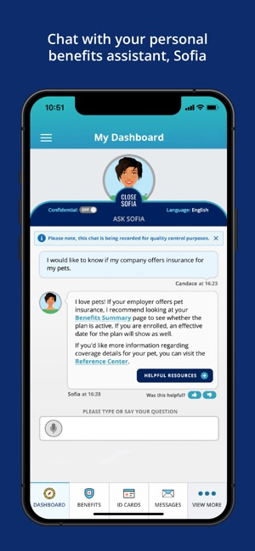
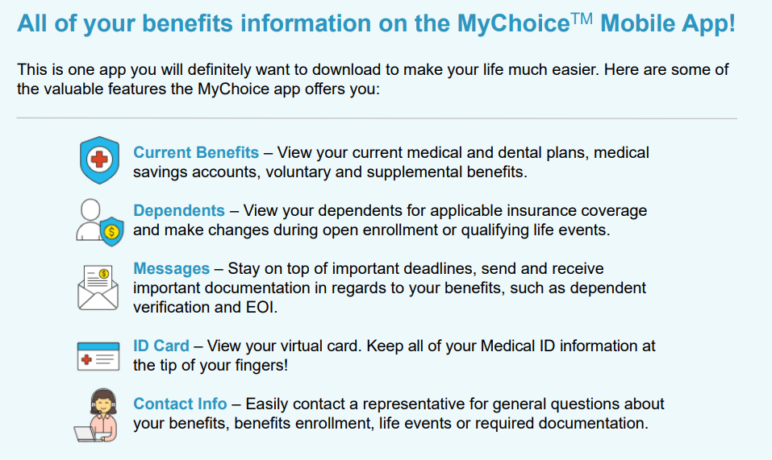


Enhanced Resources
Sometimes, you just can’t seem to find the right answers to your benefits questions. Use the resources below to get the answers you need and access your benefits year-round.
Notes:
Sometimes, choosing the perfect benefits package can be overwhelming. That’s why we are excited to offer the MyChoice Recommendation Engine. Answer a few simple questions, and you’ll soon be en
Sofia, Your Personal Benefits Assistant
Ask Sofia! Think of her like your virtual benefits assistant. She’s available to talk 24/7, and can be found anywhere your benefits choices are. Ask her a question, and she’ll point you in the right direction.
Ask Sofia! She’s available all day, every day, even through the MyChoice Mobile App. If she is unable to assist or you need to talk to a person regarding your benefits, Member Services are available from 7:00 a.m. to 7:00 p.m. CST. Member advocates can be reached at 888-887-3277, option 1. Your HSA and FSA balances, claims submission and account details will also be in the mobile app.

Slide 33
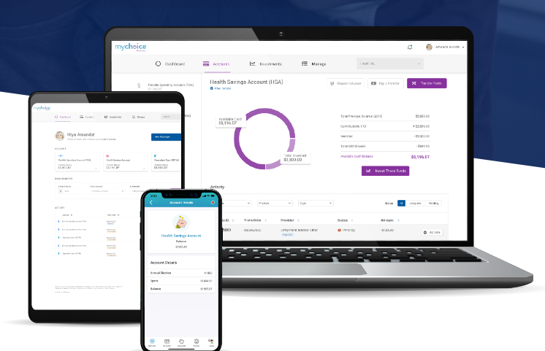
MyChoice Mobile App
Manage your benefits on the go:
The MyChoice Mobile App allows you to stay connected with your benefits wherever you are.
Check your balance
File a claim or request funds
Pay a provider
Upload documentation with your device’s camera
Contact member services
Manage bank accounts, debit card and providers
A “one-wallet” approach to benefits.
Notes:
Accessing your funds is easy!
Really nice application, you can manage your benefits, ID cards, submit a claim, and there are many other features
Reimbursement: If your account isn’t carded, or if you’d like to get reimbursed for an out-of-pocket expense, simply log on to your benefits portal or use the MyChoice Mobile App to submit a claim or fund transfer. To make it really simple, you can add your banking info for direct deposit. If you really love paper, we accept faxed and mailed forms, too.
Pay a Provider: If you want to pay a bill for an eligible expense, you may also initiate your payment online or via the mobile app (examples: doctor visit, lab fees, hospital bill). So really nice app I encourage you to go ahead and download in your mobile phone so that you get everything at your fingertips.

Slide 34

Have Questions or Need Assistance?
Ask Sofia, your virtual health benefits assistant, available 24/7 from the Transformco 2024 Annual Enrollment portal and
Businessolver MyChoice Mobile App.
You can also call the Transformco Benefits Center at 888-887-3277, select your language preference, and then select Opt. 1. Call hours are 7:00 a.m. – 7:00 p.m. Central time, Monday – Friday.

Slide 35

Questions

